Slide 1
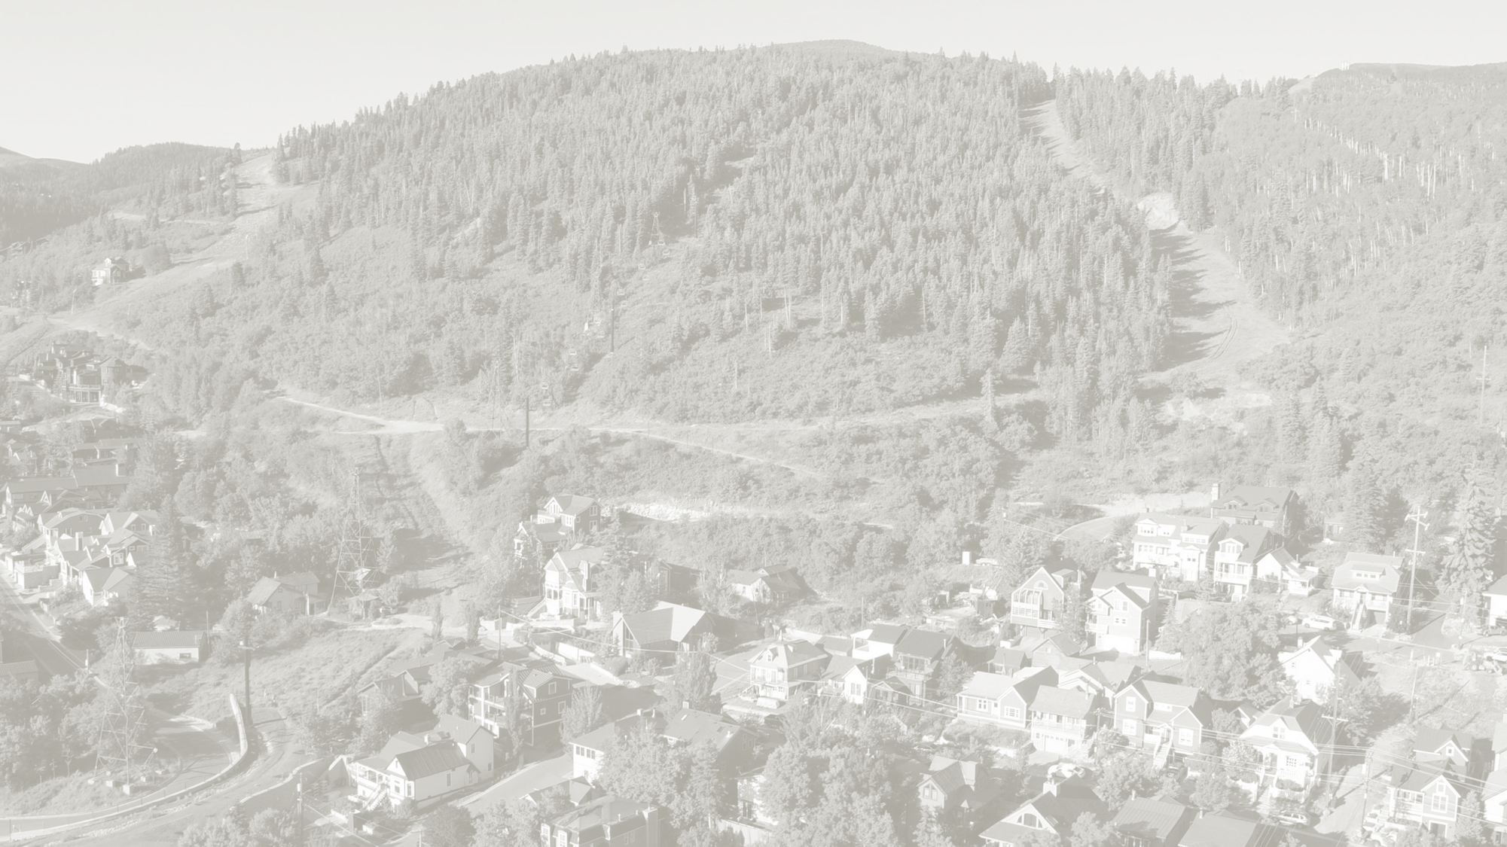
2018 Open Space Bond
August 2, 2018

Slide 2
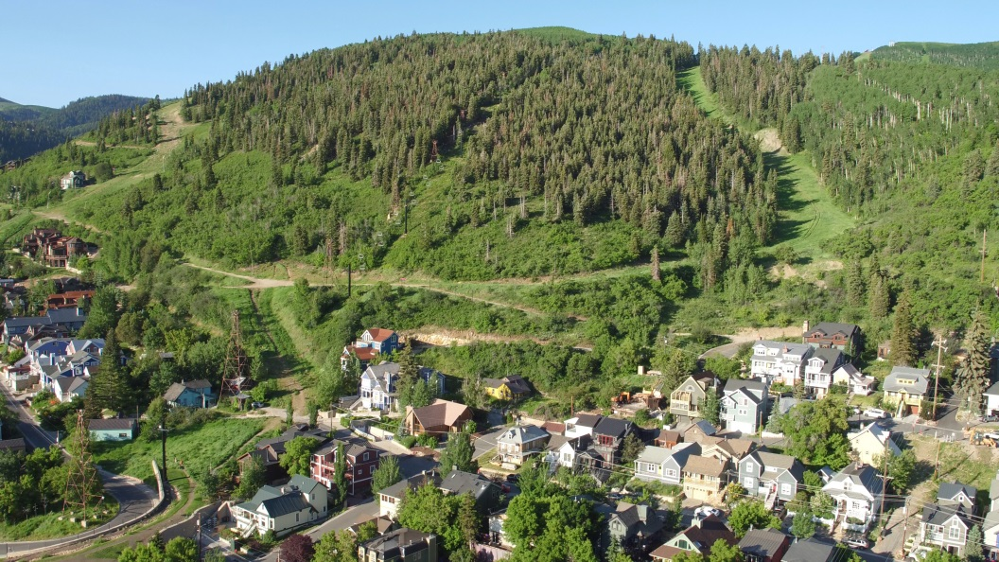
Treasure

Slide 3
History
Provide an alternative to the regulatory process (30 years of uncertainty)
Unanimous Planning Commission & City Council support
$64M Treasure purchase
-$16M in reductions = $48M Bond
$48M = Under $194/year for average house
Iconic property – Armstrong
Evaluate options w/intent to preserve both

Slide 4
Analysis
Community input
Public’s decision where to allocate our resources
Financial assessment
Both financially viable and responsible
Separate financial strategies; both require utilization of ARCST ($3M)
Combination prioritizes all available funds (ARCST) towards Treasure first
Not compulsory…provides second voter check-in
Anecdotal pros and cons

Slide 5
Financial Strength
Aaa bond rating (Bonanza Flat)
Half of GO debt is retired in next 7 years
Open Space GO bonds passed between 71% to 82% approval Rating
Primary home owner pays 15% of property tax
$48M GO Bond = $7.2M paid by primary resident
City is well below debt limit 5th lowest property tax rate in Utah

Slide 6
Recommendation
Community input critical
Public’s decision where to allocate our resources
Not compulsory to combine
Financially the prudent
Maximizes financial flexibility
Minimize tax payer impact if Armstrong purchase unsuccessful
7 years of authorization
If successful, achieves community goal to preserve both iconic properties
Combine Treasure & Armstrong

Slide 7
Timeline
Bond Resolution - Aug. 16, 2018 –
75 days prior to election date – Council approve a resolution submitting the question the voters.
The resolution must include:
The ballot proposition language,
Dollar amount (sizing) of the bonds
The maximum maturity of the bonds.
September - resolution followed by series of public hearings and notices.
Between September 24 - October 24 - voter information pamphlet mailed to all city addresses.
Voter information also includes ballot proposition language, dollar amount of bonds and maximum maturity of the bonds, as well as estimated annual property tax impact related to bonds.
November 6, 2018 - Election – Simple majority..
November - March – If passes, proceed with issuance and sale of bonds.
Closing by April 1, 2019

Slide 8
Council Questions & Public Input

Slide 9
What a Potential Combined $48 Million Treasure Hill & Armstrong Open Space Bond
Utilizes all remaining Open Space funding allocation from the Additional Resort Community Sale Tax 15-year plan – COSAC Open Space Funds

Slide 10
Current Property Tax Debt

Slide 11
Authorization
2 revenue sources would be utilized to preserve Treasure & Armstrong General Obligation Bond = Property Tax
ARCST = Sales Tax Revenue
(ARCST Vote not compulsory)
$64M Treasure Hill Purchase Price
-$16M in PCMC reductions
= $48M General Obligation Bond
GO authorization request = Up to $48M
ARCST +/- $3M
Total = $51M (GO & ARCST)
Total = $45M (GO only; Armstrong unavailable)

Slide 12
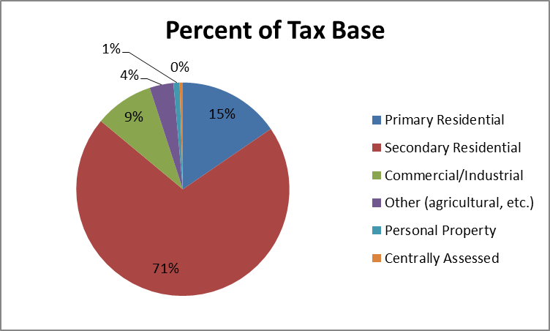
Park City Property Tax Base

Slide 13
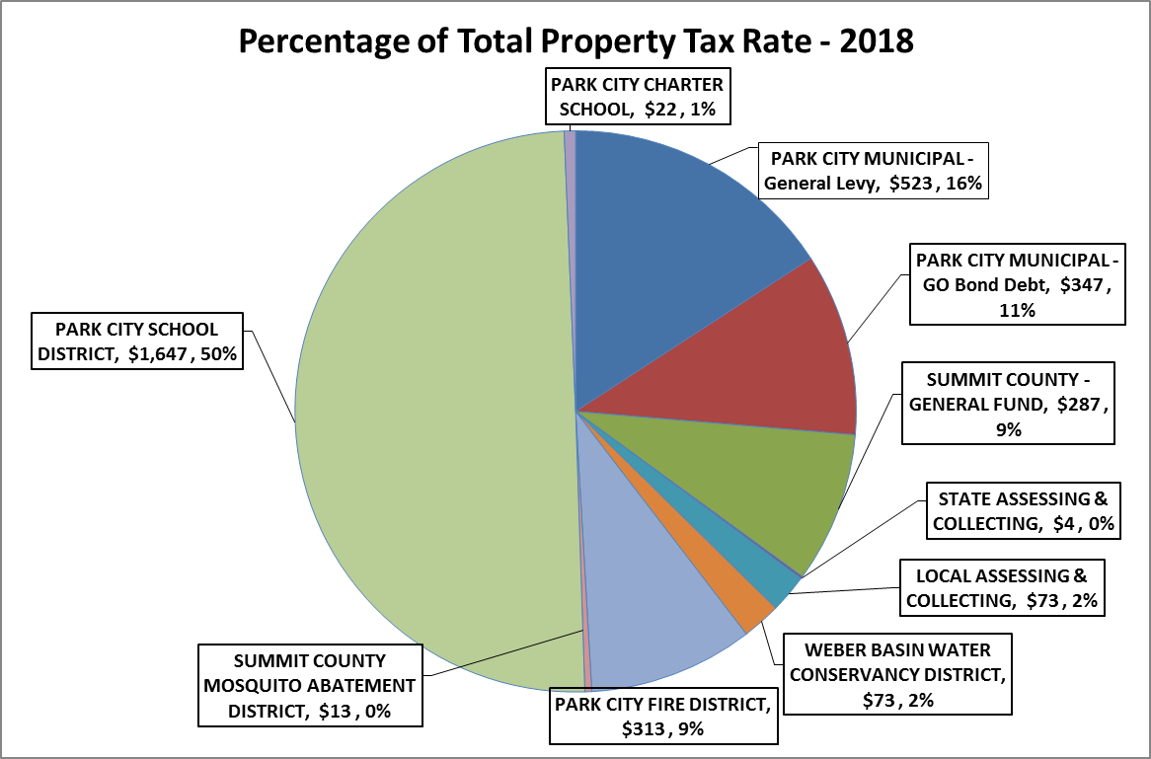
Total Property Tax Chart

Slide 14
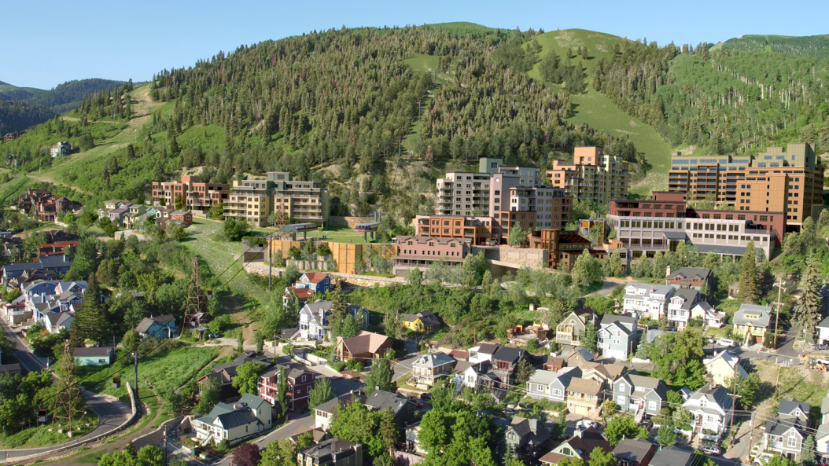
Side by Side Comparison
Refinement 17.2
Photographic Simulation
April 2017
Existing Conditions

Slide 15
By the Numbers
$64M for 100% property acquisition
62.18 acres - Potential Property Acquisition
11.5 acres (E-MPD, Hillside Properties)
50.61 acres (ROS-MPD)
.07 acres (HR-1-MPD)
42.7 acres - Current Open Space Parcel
Lot 5 Treasure Hill Phase I
Deeded over to the City in 1995
104.88 acres total – Open Space

Slide 16
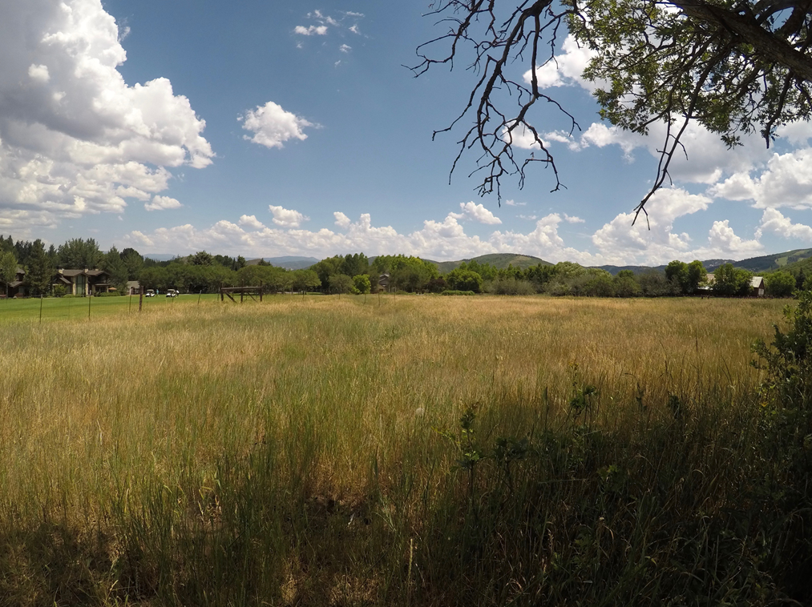
Armstrong II Open Space (Snow Ranch Pastures)

Slide 17
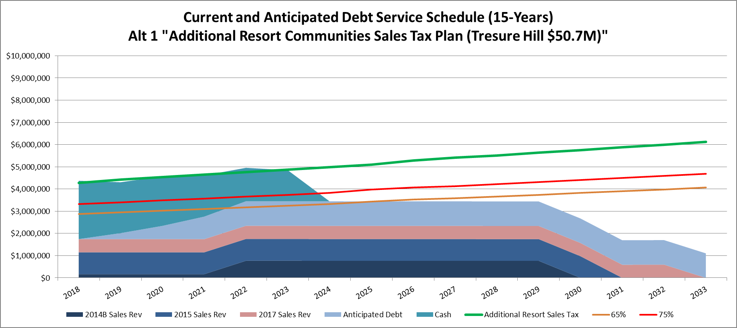
Treasure Hill – Bond Sizing Scenario
$64 M Purchase Price
$50.7 M GO Bond
$ 13.3 M from Additional Resort Sales Tax projects
$7.5 Main Street Plazas,
$1.5 Open Space funds (ARCST debt capacity)
$1.7 OTIS - Rossi Hill/ Coalition View
$0.5 Storm Water (Otis & small projects)
$2.1 Downtown Sidewalks
3.1 Remaining Open Space Funds

